Slide 1
CAPSTONE ENGINEERING PRESENTATION
LegalEase: AI-Powered Legal Document Generator
Automated, Customizable, and Structurally Compliant Legal Contract Drafting System
PRESENTED BY
ACADEMIC DEPARTMENT
PROJECT SUPERVISOR
[Student Name Placeholder]
Dept. of Computer Science & Engineering
[Guide Name, Designation]
Reg No: [Register Number]
[College / Institution Name]
Project Mentor

Slide 2

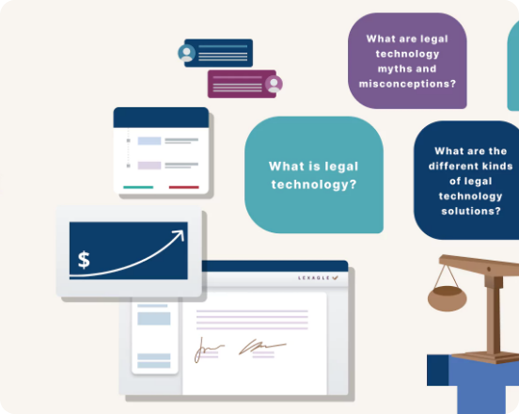
EXECUTIVE SUMMARY
Project Introduction & Context
LegalTech Meets Generative AI
Transforms semi-structured parameters into legally cohesive, publication-grade contracts in under 30 seconds.
End-to-End Contract Suite
Supports NDAs, Employment Agreements, Leases, and Freelance covenants with in-browser editing.
Multi-Format Binary Export
Instant compilation into DOCX with Terms Tables, PDF with dynamic pagination, and plain TXT.

Slide 3




INDUSTRY CHALLENGES
Traditional Legal Drafting Bottlenecks
Drafting Overhead
Rigid Templates
Prohibitive Cost
Format Degradation
Hours spent drafting boilerplate provisions repeatedly.
Static internet forms create clause contradictions.
Excessive legal counsel fees for standard routine agreements.
Broken tables, margins, and missing branding across formats.

Slide 4
COMPARATIVE ANALYSIS
Existing Methods vs. LegalEase
Traditional Systems
LegalEase Platform
Turnaround: 2 to 5 business days per draft.
Turnaround: Under 30 seconds end-to-end.
Cost: High billable legal expenses.
Cost: Zero drafting fees for standard agreements.
Adaptability: Static placeholders cause semantic clash.
Adaptability: Generative AI tailors dynamic covenants.
Formatting: Manual copy-paste breaks word layouts.
Formatting: Automated tables, logos, and pagination.

Slide 5
ENGINEERING GOALS
Core System Objectives
Rapid Turnaround
Contract Anatomy
Human-in-the-Loop
Instant synthesis under 10 seconds.
Recitals, covenants, severability, and signatures.
In-browser interactive draft verification.
Multi-Format Output
Branding Integration
API Key Security
Programmatic DOCX, PDF, and TXT compilers.
Automatic logo embedding and terms tables.
Backend environment variable isolation.

Slide 6
SYSTEM DESIGN
Two-Tier Decoupled Architecture
Streamlit Frontend
FastAPI Gateway
Google Gemini API
Format Compilers
Port 8501: UI Form, Preview Canvas & Downloads
Port 8000: Pydantic Validation & Routing
Cognitive Engine: Legal Taxonomy & Synthesis
python-docx, FPDF, and Text Writers

Slide 7
IMPLEMENTATION STACK
Technologies & Tooling Ecosystem
Frontend
Backend API
AI Cognitive Core
Compilers
• Streamlit 1.30+
• FastAPI 0.109+
• Google Gemini API
• python-docx
• Requests SDK
• Uvicorn ASGI
• google-generativeai
• FPDF2 / FPDF
• Pillow (PIL)
• Pydantic Schemas
• Prompt Taxonomy
• UTF-8 TXT Engine

Slide 8
EXECUTION PIPELINE
End-to-End System Workflow
01
02
03
04
05
Input Parameters
Schema Validation
Gemini Synthesis
Review & Edit
Binary Export
User submits parties, covenants, and dates.
FastAPI Pydantic verifies payload integrity.
LLM generates strict contractual prose.
In-browser text area preserves manual edits.
Compile to DOCX, PDF, or UTF-8 TXT.

Slide 9
ARCHITECTURE BREAKDOWN
System Modular Decomposition
UI & Input Modules
API & Validation
Formatting Modules
• Streamlit sidebar configuration
• FastAPI REST routing engine
• DOCX OpenXML generation
• Reactive document selectors
• Pydantic schema validation
• Vector PDF pagination engine
• Corporate logo uploader
• Asynchronous error handling
• UTF-8 plain text sanitizer

Slide 10

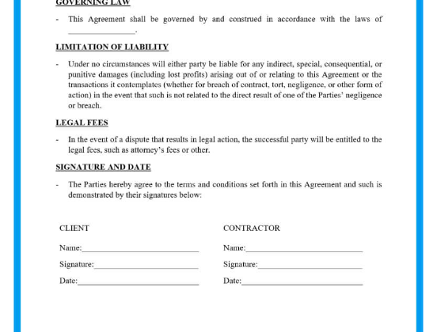
COGNITIVE LAYER
AI Integration & Prompt Engineering
Persona Enforcement
Directs model as senior corporate drafting attorney.
Structural Constraints
Enforces Title, Recitals, Operative Clauses, and Signatures.
Negative Directives
Strips conversational filler and markdown backticks.

Slide 11

OUTPUT COMPILERS
Document Compilation Engines
DOCX Formatting
PDF Formatting
TXT & HTML Preview
• Standard 1-inch margins
• Custom FPDF canvas rendering
• Clean UTF-8 encoded text
• Times New Roman typography
• Running header & dividing rules
• Cross-platform portability
• Automated Terms Summary Table
• Dynamic Page X of Y footers
• Interactive in-browser editor
• Corporate header logo insertion
• Safe Latin-1 character wrapping
• Lightweight archiving

Slide 12
PROJECT EXECUTION
Milestones 1 & 2: System Foundations
Milestone 1: Model & Architecture
Milestone 2: Core Functionalities
Activity 1.1: Selected Google Gemini API for long context reasoning.
Activity 2.1: Built prompt engineering and compilation pipelines.
Activity 1.2: Established decoupled Streamlit + FastAPI architecture.
Activity 2.2: Created Pydantic request models and DOCX formatters.
Activity 1.3: Isolated Python 3.10+ venv and .env credentials.
Activity 2.3: Implemented in-browser editing canvas in session state.

Slide 13
PROJECT EXECUTION
Milestones 3 & 4: Integration & UI
Milestone 3: API Logic
Milestone 4: Frontend Development
main.py: Initialized CORS middleware and GET / health check.
app.py: Designed sidebar controls and responsive 2-column view.
routes.py: Defined POST /generate route with DocumentRequest.
Interactive Editor: Two-way data binding for live contract review.
Resilience: Built HTTP 422 validation and HTTP 500 fallbacks.
Export Tray: One-click in-memory binary download triggers.

Slide 14
DEPLOYMENT VERIFICATION
Milestone 5: Deployment & Testing
Local Execution Commands
Verification Checklist
$ uvicorn main:app --reload --port 8000
Health-check endpoint operational (GET /)
$ streamlit run app.py --server.port 8501
Payload validation prevents malformed requests
In-browser edits persist to downloaded DOCX & PDF
Both servers run concurrently with CORS enabled for seamless communication.
Corporate logo embedded with proper aspect ratio

Slide 15
FIELD VALIDATION
Real-World Deployment Scenarios
Startup Hiring
Freelance NDA
Residential Lease
Role: Senior Engineer Onboarding
Role: AI Consultant Pitch
Role: Property Management
Automates compensation terms, IP assignment, 60-day probation, and confidentiality clauses.
Defines proprietary algorithms as protected assets with 3-year mutual confidentiality.
Compiles rent schedule, security deposits, quiet hours, and maintenance obligations.

Slide 16
QUALITY ASSURANCE
Comprehensive System Testing Matrix
Test ID | Scenario | Expected Result | Status
TC-01 | Valid Contract Generation | HTTP 200; complete legal text generated | PASSED
TC-02 | Empty Party Submission | HTTP 422 validation error caught cleanly | PASSED
TC-06 | In-Browser Text Editing | Edits persist into session state and exports | PASSED
TC-07 | DOCX Table & Logo | OpenXML rendered with table and header logo | PASSED
TC-08 | PDF Dynamic Pagination | Vector-clean Page X of Y footers without overflow | PASSED

Slide 17
EMPIRICAL OUTCOMES
Performance & Output Quality
4–8s
100%
3
Average document generation turnaround
Pass rate across functional test suites
Production formats: DOCX, PDF, and TXT
"Drastically compresses manual contract drafting turnaround from hours to seconds while preserving user agency."

Slide 18
SYSTEM EVOLUTION
Future Roadmap & Enhancements
PHASE 1
PHASE 2
PHASE 3
Legal Corpus RAG
Contract Risk Analysis
E-Signature & Cloud
Grounding document synthesis with state statutes and jurisdictional court precedent databases.
Automated risk assessment scoring to identify ambiguous clauses and unfair liability terms.
Cryptographic signing integration with cloud-native Docker and AWS microservice deployment.

Slide 19
CAPSTONE DEFENSE CONCLUSION
Thank You!
LegalEase successfully democratizes legal contract drafting by uniting Generative AI reasoning with high-fidelity multi-format document compilers.
Open for Viva Examination & Questions

Slide 20


Image Sources
https://cdn.prod.website-files.com/61dbb38f6612f97003df0f0d/664c32ffece48ec4ec243063_Contracts%20Series%207%20Banner.webp
Source: www.lexagle.com
https://signaturely.com/wp-content/uploads/2020/06/independent_contractor_agreement_template3.jpg
Source: signaturely.com

